Slide 1
Organization strategy phase
IS205
Jan-19
Dr. Ibrahim Abunadi

Slide 2
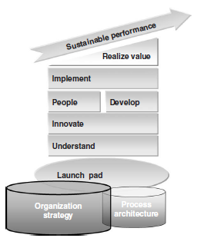
Organisational Strategy Phase

Slide 3
Why organisational strategy
Organizational alignment is an essential part of getting results within an organization, and there are many elements that need to be brought, or kept, in alignment.
The goal should be to ensure that BPM projects have a clear link to the organization’s strategy and add value to it. Often BPM projects operate within ‘pockets’ of the organization and appear to have no link to the organization’s strategy.
However, every organization and every project should spend sometime to understand the organization strategy and ensure that the project is adding value towards defined strategic outcomes.
The depth and extent of the review depends on the importance of the project to the organization and the management level you are dealing with. If a project cannot clearly demonstrate that it is adding value to an organization and its strategic direction, it should not be undertaken.
Many projects are justified because they are of a tactical nature, but many tactical solutions become long-term solutions. (p.66)

Slide 4
Strategic Intent
Hamel and Prahalad (1994), based on strategic intent book. They wrote: ‘if Strategic Architecture is the brain, then strategic intent is the heart’.
The three attributes that an organizational strategic intent will provide are as follows:
  A sense of direction – a particular point of view about the long-term market or competitive position that an organization hopes to build over the coming decade or so.
  A sense of discovery – this implies a competitively unique point of view about the future.
  A sense of destiny – this adds an emotional edge to the strategy, and is a goal that employees perceive as being inherently worthwhile. (p.67)

Slide 5
Why involve strategy in BPM?
Processes are not an end in themselves, but rather a means to achieving a business objective. The selection of a business objective and the approach to achieving that objective is the strategy of the organization.
The management team is responsible for selecting the organization objectives and ensuring that the processes support, or contribute to, the fulfilment of the objectives, as seen in Figure below.
Thus processes that are aligned with the strategy and objectives are most effective in achieving these objectives and are more sustainable in the medium to long term. It is important that while formulating strategy, the current processes, their strengths, weaknesses, possibilities and constraints are taken into account.
A significant percentage of failures in deploying an organization strategy, and obtaining the anticipated benefits, are caused by ignoring the impact of the strategy on business processes during the strategy formulation steps. It is easy to develop a strategy in isolation, but to ensure that the strategy actually works throughout the organization is far more challenging. (p.67 & 68)

Slide 6
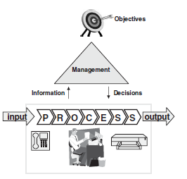
Context of Strategy and Process (p.68)

Slide 7
Case study: Only a view of today
An airline company wanted completely to reorganize its business processes relating to freight. We started this engagement by meeting with all the stakeholders and asking them about their strategic views for the organization.
One of the marketing managers objected to this approach, saying that all the requirements for the processes were already specified in the Request for Information (RFI). However, her colleagues were speaking about fundamental business changes – further collaboration with a wide variety of partners, additional products and services, new methods of payments and new business models.
After hearing this, the marketing manager realized she had drafted the RFI on the basis of the current problems within the business processes and focused on the immediate current requirements. If we had proceeded on the basis of the original RFI and redesigned the processes accordingly, without linking them to the organization’s strategy, this would have caused the processes to be outdated before they were implemented.
Message: Take time for reflection before getting lost in detail. (p.67 & 68)

Slide 8
Case study: Forgetting a detail
A large distributor of goods went through a strategic business re-orientation. Managers decided that they wanted to increase revenue. To achieve this, they needed to significantly improve resource planning and the level of automation within the organization. Their solution was to implement a new Enterprise Resource Planning system and change all their processes to accommodate the new ERP system.
Instead of obtaining more orders, they experienced a dramatic fall in orders. After analyzing why this had occurred, they realized that they had forgotten one important detail in their strategic analysis: their delivery process was unique, as they were the only organization that provided goods within 24 hours. With the changing of the processes to suit the new system, they were no longer able to meet this deadline.
Message: Validate any process solution with your original business case and your strategy.

Slide 9
Results of this phase
The deliverables of the Organization strategy phase have significant input into the next phase, Process architecture, and include:
A documented version of the organization’s:
  vision
  mission
  goals
  strategic intent
  objectives
  implementation strategy.
A context or business model, which includes:
  customers (type and volume of customers)
  services/products
  suppliers/partners
  key differentiators
  resources.
Key differentiators of the organization. (p. 69)

Slide 10

Organisational Strategy steps
The steps involved in aligning organization strategy and the BPM project are shown in the Figure:
The depth and duration of each of the steps specified varies from project to project and organization to organization. The crucial issue of these steps is that they are at the very least considered before going on to the next step. (p.69)

Slide 11
Step 1: Analyze internal and external aspects of the organization
During this step, the organization should review the internal and external aspects of the organization. By this we mean understanding the internal strengths, weaknesses, competencies and constraints of the organization and, on the external side, the competitive and environmental impacts upon the organization.
The effort and level of detail involved in this exercise depend on the BPM scenario selected. In the case of an ‘in the driver’s seat’ scenario, this step should be completed in more detail than in the case of an ‘under the radar’ scenario. Useful models to assist in this step are:
  SWOT analysis (Porter, 1980)
  core competencies (Hamel and Prahalad, 1994).
  competitive forces (Porter, 1980)
  environmental aspects (Porter, 1980). (p.70)

Slide 12
Step 2: Make strategic choices 1/3
After the analysis step, strategic choices should be made and documented. In the case of an ‘in the driver’s seat’ scenario, it is crucial to ensure that the questions specified below are answered and that the answers are completely up to date. In the case of an ‘under the radar’ approach, it is usually sufficient to have a clear understanding of most of these elements, without the need completely to rework and align each of the answers with the BPM project.
Key questions:
  Vision: what does the organization strive to ‘be’?
  Mission: what is the organization in business to ‘do’?
  Goals: what does the organization plan to accomplish?
  Strategic intent: how are we going to achieve the goals and objectives?
  Objectives: what results does the organization plan to deliver?
  Implementation strategy: what methods or approaches are used to reach the goals and performance targets? (P.70)

Slide 13
Step 2: Make strategic choices 2/3
To answer these questions, outline two of the most helpful methods and models that are appropriate for BPM are outlined:
1 Treacy and Wiersma (1997) suggest that a company must choose between three strategic options:
  customer intimacy – the best total solution for the customer
  operational excellence – the best total costs
  product leadership – the best product.
They say that it is impossible for an organization to be a leader in all three strategic options. Organizations must make a choice of one of these dimensions, otherwise they become ‘stuck in the middle’ (Porter, 1980) and will eventually not survive.
From a process perspective, this is one of the main choices that will impact each individual business process.
From a BPM project perspective, it is crucial to gain a clear understanding of the direction the organization wishes to choose, because the choice will have a significant affect upon the approach to the project.
Reviewing and (re)designing processes is impossible without this choice, because processes are all about making the right choices to achieve the desired results via the chosen strategy. Without the clear formulation of this strategy it becomes unclear how the processes should contribute to the organizational results, leading to inconsistent choices at the lower management level and, eventually, the inability of the executive management to steer the direction of the processes, organization and people. (p.71)

Slide 14
Step 2: Make strategic choices 3/3
2 The strategy maps of Kaplan and Norton (2004) describe how an organization creates value by connecting strategic objectives in explicit cause-and-effect relationships in the four Balanced Score Card objectives (financial, customer, business processes, learning and growth).
The strength of this model is that it involves the same method of formulating the strategy, and eventually measuring its success, through a Balanced Score Card approach.
Processes are crucial in the strategy maps of Kaplan and Norton because they enable the realization of organizational targets and are fundamental in enabling the organization to plan, act, measure and check work.
Too often the creation and monitoring of a Balanced Score Card is completed separately from the processes that must deliver the results. This leads to inefficiency, ambiguity, and risk of focusing on the incorrect elements.
The strategy maps of Kaplan and Norton ensure that, at the creation of the Balanced Score Card, the processes are taken into account. (p.71)

Slide 15
Step 3: Determine impact on processes
In this step, the impact of the organization strategy on the business processes is briefly reviewed.
This is applicable to all four scenarios mentioned previously (‘business as usual’, ‘in the driver’s seat’, ‘pilot’ and ‘under the radar’).
The relevant models that have been presented in this chapter will be used to describe the impacts.
The impact on the processes will be influenced not only by the organization strategy, but also by the analysis that should have been completed as part of the analysis of the internal and external aspects of the organization (performed in Step 1) and the determination of the strategy (performed in Step 2).
This includes:
    ● strategic choice
    ● core competencies
    ● competitive forces
    ● SWOT analysis. (p.71 & 72)

Slide 16
Step 3: Determine impact on processes 1/3
Strategic choice:
Strategic choice should be analyzed from a business process perspective.
It is important to obtain upfront consensus on the strategic choices, because only then can agreement be achieved on the processes to support the strategic choice.
Once the strategic choice has been determined and agreed, it is possible to view the impact and consequences of this choice on the processes.
(p.72)

Slide 17
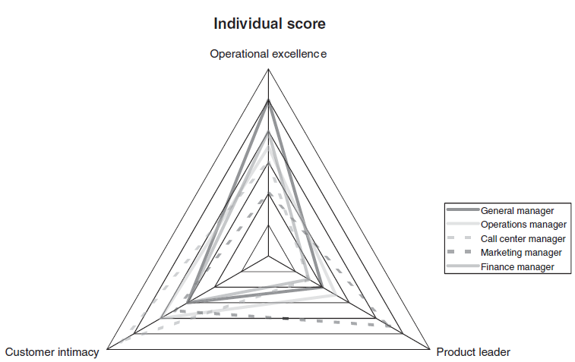
Strategic choice questionnaire sample results
The Figure is the result of a completed strategic assessment survey. This example clearly shows that the various people have different views on the strategic choices within the organization, and it can be clear that the general manager (operational excellence), the call center manager (customer intimacy) and the marketing manager (product leadership) have very different ideas about the strategy. (p.72)

Slide 18
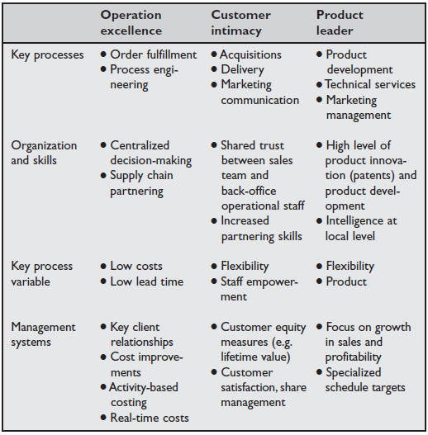
Impact of strategic choice on business processes
p.73

Slide 19
Step 3: Determine impact on processes 2/3
Core competencies
Core competencies (Hamel and Prahalad, 1994) is an inside-outside corporate strategy model that starts the strategy process by thinking about the core strengths of an organization. This is based on the belief that, in the long run, competitiveness derives from an ability to build the following, at lower cost, better or faster than competitors.
1 New products, services and markets. Modularity of processes could enable new products or services to be available faster and more cheaply than otherwise. With customers desiring increased personalization of services and products, the ability to build on existing process modules and processes will significantly benefit the competitiveness of the organization. In addition, when an organization has a good product development process that is timely, involves the right people and integrates product development and operations, it could provide better and faster product and service development. A variation on this is to adopt a strategy of ‘smart adopter’. This implies that the organization does not complete all the groundbreaking research and development itself, with the associated costs and risks. Rather, the organization arranges its processes in such a way that it is able quickly to copy successful products and services from competitors. (p.71 & 72)

Slide 20
Step 3: Determine impact on processes 3/3
  1 New products, services and markets.
  2 Fundamental customer benefit. All processes should be focused on delivering customer benefit. This doesn’t arise by chance, but by systematic and consistent design and execution within an organization’s processes. Remember that customer perception is very fragile: it takes a large investment to build it, and it can be lost instantly if one or more of the processes or involved employees doesn’t live up to this expected benefit. The customer benefit must be specified upfront, and every step should specify how it will contribute towards this.
  3 The ability to be competitively unique. Ideally, all core processes and related supporting processes should include a level of unique competitiveness. To gain a competitive advantage is tough, and ensuring that it is sustainable is even tougher. This requires all processes, including the core and supporting processes, to be focused on maintaining the competitive advantage and taking market trends, competitors and substitutes into account on a continuous basis. Reviewing and maintaining this competitive advantage could involve migrating to another business model or different customers, or including additional products and services. (p.73 & 74)

Slide 21
Case study: Agility as strategy
A telecommunications organization was reviewing its organization strategy and in the process reviewed its value chain. This didn’t provide any major differentiators or ideas for the strategy. While reviewing the organization’s strengths and weaknesses, managers realized that one of their major strengths was their ability to launch new products and services quickly. As a result of this, they selected agility as a central aspect of their strategy and chose the approach of a smart adopter organization: they would not be at the forefront of innovation in their marketplace, but innovative breakthroughs would be quickly adopted and rolled out.
Message: Selecting the right strategic choice is easier, and likely to be effective, once an organization understands its core strengths. Linking this to processes can provide a source for competitive advantage. (p.74)

Slide 22
Step 3: Determine impact on processes 4
Competitive forces
It is crucial to realize that each of the five aspects of Michael Porter’s competitive forces analysis (that is, entry of competitors, threat of substitutes, bargaining power of buyers, bargaining power of suppliers, and rivalry among the existing players) has process components.
The bargaining power of suppliers can be reduced if generic processes are in place to deal with suppliers. On the other hand, the bargaining power of buyers can be reduced when the selling organization has been able to ‘lock the customer in’ with specific customized processes.
These forces are very useful in reviewing the various strategic ‘what if ?’ scenarios and then evaluating the impact on the organization’s processes for example, how will the processes be impacted if more competition or substitutes enter the market, or what will happen with changes in legislation? Without understanding and conducting ‘what if?’ scenarios, it could be that with a change in circumstances the organization’s strategy may have to be changed unexpectedly, or the business processes may require changing at a high cost. (p.74)

Slide 23
Case study: ‘What if ?’ analysis
A telecommunications organization wanted to introduce a new business unit for a particular market segment. In their initial proposal managers claimed that they only needed one type of billing process and there was no need for flexibility: time-to-market was essential. Reviewing the requirement the same day, we asked many related ‘what if?’ questions. It soon became clear to the managers that the organization needed flexibility in its billing processes and to differentiate between residential and business accounts. We were able to prepare these billing processes in a fraction longer than originally planned, but they were able to meet the requirements of the business, not only during launch but long afterwards. The organization was grateful as managers came to realize this saved them substantial time and money (as they would have had to replace their initial billing system within twelve months) for the small amount of additional time required to conduct ‘what if?’ reviews.
Message: Think broader than your initial scope by asking many ‘what if?’ questions. (p.75)

Slide 24
Step 3: Determine impact on processes 5
SWOT analysis
The completion of a business process SWOT analysis may reveal some processes as being significant ‘strengths’ and others significant ‘weaknesses’. This will have major consequences for the business model of the organization.
For example, it could allow the processes which are major strengths to become the core processes of the organization and perhaps provide strategic opportunities, such as process ‘in-sourcing’.
At the same time, if other processes are significantly weaknesses, ‘outsourcing’ could be considered. If the process of the IT helpdesk is a significant weakness, then the organization could decide to outsource these processes and focus all its energy and resources on the processes that are performing well. Whichever choice is selected, the business model will change. (p.75)

Slide 25
Step 3: Determine impact on processes 6
Performance prism
The performance prism (Neely et al., 2002) is a performance measurement and management framework. It considers all the stakeholders in a two-way relationship on one hand considering what the stakeholders want and need, and on the other hand what the organization itself wants and needs from its stakeholders.
It involves the following five facets:
  ● stakeholder satisfaction
  ● stakeholder contribution
  ● strategies
  ● processes
  ● capabilities.
Some of the key questions that should be considered are:
  ● What critical processes do we require if we are to execute these strategies?
  ● What capabilities do we need to operate and enhance these processes?
  ● What contributions do we require from our stakeholders if we are to maintain and develop these capabilities?
This method helps to bring stakeholders into full context and relate them to the business processes. Leaving them out might result in processes not meeting the requirements of the stakeholders, and eventually requiring changes that were not anticipated and could be expensive and difficult to implement.(p.75)

Slide 26
Step 3: Determine impact on processes 7
Performance prism (continue)
In this step, high-level measures should be specified that will provide the organization with the ability:
  ● to measure and monitor the progress of the strategy execution
  ● to provide, from middle management downwards, more specific and personal objectives
  ● to evaluate initiatives and projects by their contribution to these strategic measures.(p.75)

Slide 27
Step 4: Establish strategic measurements 1
Balanced Score Card
The Balanced Score Card (Kaplan and Norton, 1996) provides the ability to quantify the organization’s targets in alignment with the strategy and vision.
The strategic maps, as outlined previously, can be directly related to the Balanced Score Card. The four perspectives that are taken into account are:
  ● the financial perspective
  ● the customer perspective
  ● the business process perspective
  ● the learning and growth perspective.
For each of these perspectives, the following items are specified:
  ● objectives
  ● measures
  ● targets
  ● initiatives. (p.76)

Slide 28
Step 4: Establish strategic measurements 2
Balanced Score Card
The Balanced Score Card is an excellent method to specify organizational objectives at a high level and ensure that the underlying processes and organizational units provide the aggregated output to meet these objectives.
The Balanced Score Card’s four dimensions allow short-term profits and more sustainable actions to be included. As stated earlier, it is crucial that it is related to the business processes and that these business processes provide a real-time view of the status of the progress on the Balanced Score Card items. (p.76)

Slide 29


Step 5: Complete the plan 1
The strategy and main decisions should be documented in a strategic plan.
This should contain the overall enterprise objectives, as well as the main strategic choices which have been discussed in the previous steps. Remember that strategy is not just about specifying objectives, it should also provide the organization’s guidelines on how to achieve these objectives.
The following framework (Figure below) is used, which is the basis for the process architecture that will be developed in the second phase of the framework.
The strategic plan should also include an action plan, as well as general principles. (p.77)

Slide 30
Step 5: Complete the plan 2
Overall objectives
Overall objectives are those that an organization, or business unit, want to achieve. This information is normally already present within the organization, for example, ‘10 percent increase of turnover’.
General principles (strategic choices)
General principles are derived from the organization’s vision and strategy, and form the strategy level of the organization (process) architecture. They are simple statements that should be able to be understood by everyone in the organization, for example:
  ● ‘the organization follows an Operational Excellence Strategy (this will be taken into consideration while evaluating existing processes and (re)designing new processes)’
  ● ‘the customer has a single point of contact for all his or her questions (all processes will be described as end-to-end processes)’. (p.77)

Slide 31
Step 6: Sign-off and communication
Last but not least, it is essential to obtain formal sign-off on the results of the previous steps as well as communicating them to all stakeholders.
The sign-off is a crucial step, because all the decisions must be completed in a formal way.
The greater the organizational impact of the project (as in the ‘in the driver’s seat’ scenario), the more crucial it is to have true commitment from all key stakeholders rather than just lip service. In the scenarios with limited impact on the organization (e.g. as in ‘under the radar’), the sign-off is a formal step of checking that all relevant information has been completed and has been made available.
From the moment sign-off is obtained, there must be a strict change management approach to any additional changes to the organization strategy, just like any scope changes in a project.
Communication of the organization strategy and how it impacts business processes is critical, as it aims to unlock the organization from its current situation. The Organization strategy phase is the foundation of any BPM program/ project: it provides the purpose, and it guides and motivates the people within the organization and project. (p.77 & 78)

Slide 32
Organization strategy outputs 1
The Organization strategy phase outputs (Figure below) will provide valuable input into other phases of the framework:
  ● In creating a process architecture for an organization, the objectives and goals specified in the Organization strategy will need to be understood
  ● When establishing a project scope and writing the initial business case, the project team must ensure that it is adding value to the objectives and goals of the organization
  ● The results of this phase should be presented and taken into account during the Innovate phase, as the Innovate phase is where new processes will be developed that need to be inspired by and aligned with the organization strategy.
In fact, all phases of a project will need to reference and clearly understand the outcomes of the Organization strategy phase to ensure that each step in the project is adding value to the organizational objectives. (p.78)

Slide 33
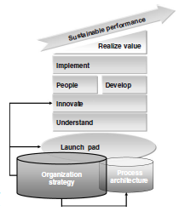

Organization strategy outputs 2 (p.78)

Slide 34
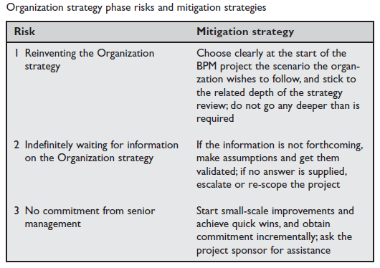
Organization strategy phase risks
A few of the most common risks involved in the Organization strategy phase are listed in the Table below. (p.79)

Slide 35
References
Most slides are directly quoted or paraphrased from the following book(s):
Jeston and Neils, (2006) Business Process Management, Practical Guidelines to Successful Implementations.
Slides are prepared by Dr. Ibrahim Abu Nadi
All page numbers are from Jeston and Neils (2008), unless explicitly mentioned which reference it comes from.

